Slide 1
Route Optimization & Demand Forecasting
CB.SC.P2AIE25016 | CB.SC.P2AIE24028 | CB.SC.P2AIE007
P K SANGAMESWAR | Samyuktha Senthilkumar | Janarthana Prabu S
Case study Review 2
Professor – T Senthil Kumar ( CSE)

Slide 2
Agenda
Introduction
Architecture & Literature survey
Features of LSTM
CV perspective of LSTM
Diagram
Why LSTM?
Hyperparameters
Hyperparameter Tuning
Metrics
Formulae for performance metrics

Slide 3
Introduction
Route Optimization – In My Understanding
In my understanding, route optimization is about finding the best possible path for vehicles to travel so that deliveries can be completed faster, at lower cost, and with less fuel usage. It focuses on choosing routes that avoid heavy traffic, long delays, and unnecessary distance. The main goal is to reduce travel time, operational cost, and carbon emissions while ensuring timely delivery.
Demand Forecasting – In My Understanding
In my understanding, demand forecasting is about predicting when and where transportation demand will occur in the future. By analyzing historical data such as trip timings, locations, and frequency, we can estimate future demand patterns. This helps in planning how many vehicles are needed and where they should be positioned in advance.
What is Deep Learning for Route Optimization & Demand Forecasting?
In my understanding, deep learning for route optimization and demand forecasting involves using advanced neural networks to learn patterns from large amounts of time-based transportation data. Instead of manually defining traffic rules or demand patterns, deep learning models automatically learn trends such as rush hours, congestion behavior, and seasonal variations. This helps the system make smarter predictions and better routing decisions.

Slide 4
What is LSTM and What Does It Do Here?
In my understanding, Long Short-Term Memory (LSTM) is a type of deep learning model that is especially good at handling time-dependent data. Since traffic conditions and demand change over time, LSTM can remember past patterns and use them to predict future travel times and demand levels. LSTM helps in forecasting delays, congestion, and demand more accurately than traditional models.
Why is Deep Learning Needed for This Problem?
Deep learning is needed for route optimization and demand forecasting because traditional methods struggle to handle complex and dynamic real-world traffic conditions. Traffic patterns are influenced by time, location, congestion, and external factors, making them difficult to model manually.
By using LSTM-based deep learning models:
Long-term traffic and demand patterns can be learned
Travel time predictions become more accurate
Route decisions become adaptive and data-driven
Fuel consumption and carbon emissions can be reduced
This makes deep learning a powerful solution for modern transportation and logistics systems.

Slide 5
Architecture & Literature survey
Proposed System Architecture (High-Level)
Data Sources → Demand Forecasting → Route Optimization → Execution & Feedback
Data Sources: Historical orders, real-time requests, traffic data
Demand Forecasting Module: Time-series / ML models predict future demand
Route Optimization Module: Optimization algorithms generate cost-efficient routes
Execution & Feedback: Delivery execution + real-time updates improve future predictions
Literature Survey (Condensed & Mapped to Architecture)
Architecture Component | Key Insight from Literature
Demand Forecasting | ML-based forecasting improves supply-chain planning accuracy
Route Optimization | Demand-aware routing reduces cost, delay, and fuel usage
Integrated Approach | Joint forecasting + routing outperforms isolated solutions

Slide 6
Key References (IEEE & Google Scholar )
Mohan, B. A., et al., Demand Forecasting and Route Optimization in Supply Chain Industry Using Data Analytics, IEEE ASIANCON 2021. https://ieeexplore.ieee.org/document/9544942
Mohan, B. A., et al., Integrating Passenger Incentives to Optimize Routing for Demand-Responsive Systems, IEEE Access, 2021. https://doi.org/10.1109/ACCESS.2021.3055855
Google Scholar – Demand-Aware Vehicle Routing Studies https://scholar.google.com/scholar?q=demand+forecasting+route+optimization

Slide 7
Features of LSTM
Ability to remember information for long periods LSTM can store important information over long time intervals, which helps in learning long-term patterns in data.
Handles time-dependent data effectively LSTM is specially designed for sequential and time-series data where past information affects future predictions.
Gating mechanism LSTM uses three gates—input gate, forget gate, and output gate—to control what information should be stored, updated, or removed.
Prevents vanishing gradient problem Unlike traditional RNNs, LSTM maintains a stable error flow, allowing effective learning even for long sequences.
Selective memory LSTM learns what information is important and what can be ignored, improving prediction accuracy.
Robust to noisy data It can handle irregular or noisy sequences such as traffic data or user behavior patterns.

Slide 8
Why LSTM?
Traffic and travel data are time-dependent Route efficiency depends on past traffic conditions. LSTM is designed to model such time-series data.
Learns long-term traffic patterns LSTM can capture daily, weekly, and seasonal congestion trends that affect route performance.
Accurate travel-time prediction By learning from historical trip data, LSTM predicts future delays more accurately, helping choose faster routes.
Handles dynamic and non-linear traffic behavior Real-world traffic is complex and unpredictable. LSTM adapts well to these variations.
Reduces fuel cost and carbon emissions Better travel-time predictions help avoid congested routes, leading to less fuel usage and lower CO₂ emissions.
Works well with large real-world datasets LSTM scales effectively with large transportation datasets like the TLC Trip Record Data.
Supports real-time and predictive routing decisions LSTM predictions can be fed into routing algorithms to dynamically select optimal routes.

Slide 9
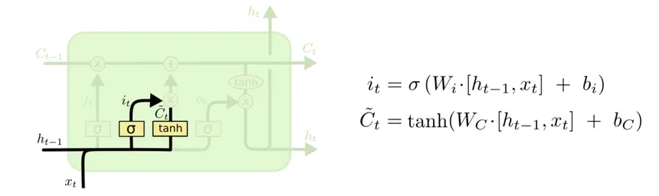
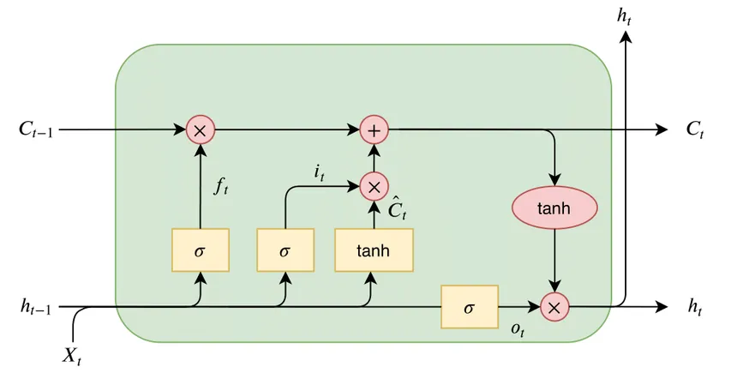
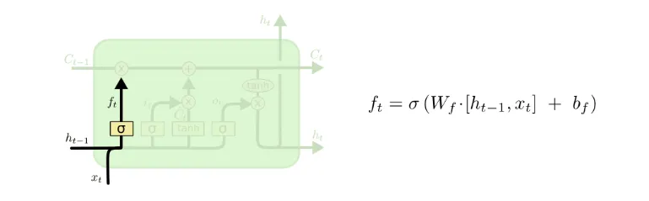
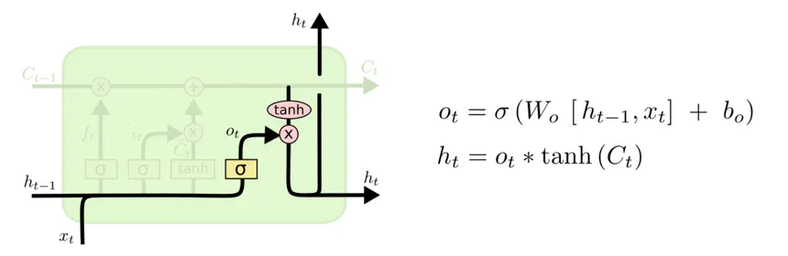
Diagram
LSTM Architecture

Slide 10
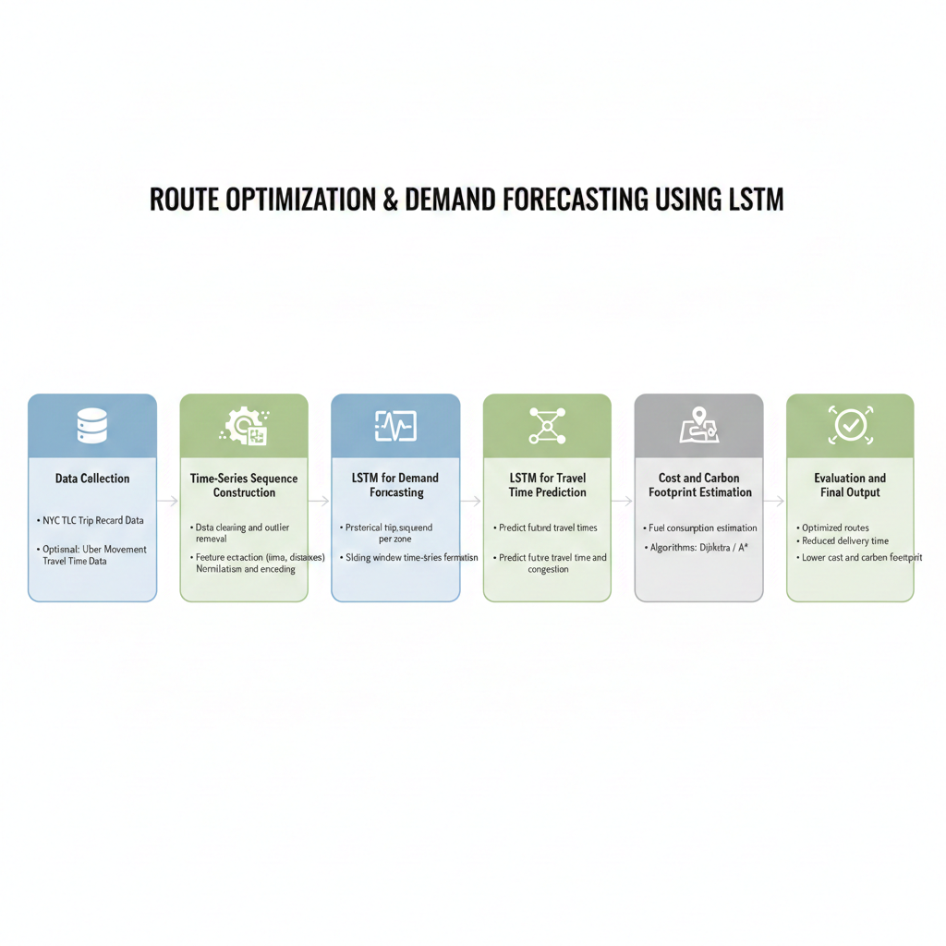

Slide 11
Methodology of Approach
1. Dataset Selection
The NYC TLC Trip Record Data is used as the primary dataset. It contains time-stamped trip information such as pickup/drop-off locations, trip duration, distance, fare, and congestion charges, making it suitable for time-series analysis and route optimization.
2. Data Preprocessing
Remove incomplete, noisy, and invalid trip records
Handle outliers such as zero-distance or abnormal-duration trips
Extract temporal features (hour, day, peak/off-peak)
Normalize numerical features for stable LSTM training
Encode pickup and drop-off zones
3. Time-Series Sequence Construction
Group trip data by location and time
Convert historical data into sequential input windows
Create sequences where past T time steps predict the next value

Slide 12
4. Demand Forecasting using LSTM
Train an LSTM model on historical trip counts
Learn temporal demand patterns across zones
Predict future demand for different locations and time intervals
5. Travel Time Prediction using LSTM
Use another LSTM model to learn patterns in trip duration and distance
Predict future travel times considering time-of-day effects
Output estimated travel times between zones
6. Route Optimization
Use predicted travel times as edge weights in a routing graph
Apply shortest-path algorithms (Dijkstra / A*)
Select routes that minimize:
travel time
operational cost
fuel consumption

Slide 13
7. Cost and Carbon Footprint Estimation
Estimate fuel usage based on predicted travel time and distance
Compute CO₂ emissions
Compare optimized routes with baseline routes
8. Model Evaluation
Evaluate LSTM models using MAE, RMSE
Measure reduction in:
travel time
cost
carbon emissions
Validate results on test data
9. Final Output
Optimized routes
Forecasted demand hotspots
Reduced delivery time
Lower cost and environmental impact

Slide 14
Hyperparameter Table for LSTM
Hyperparameter | Description | Values Used in Paper
Sequence Length (p) | Minimal input sequence length | 100, 500, 1000
Time Lag (N) | Minimal steps between relevant input and target | 40, 50, 100, 250, 500
# Cell Blocks (b) | Number of memory cell blocks | 2 or 3
Block Size (s) | Units per cell block | 1, 2, 8
# Input Units (in) | Dimensionality of input | 1, 2, 8
# Output Units (out) | Output dimensions | 1 or 4
# Weights (w) | Total trainable parameters | 93, 102, 156, 308
Connectivity (c) | Network connectivity type | F → Full recurrent within hidden layer
Output Gate Bias (ogb) | Initialization | Values like -2, -4, -6 or random (r)
Input Gate Bias (igb) | Initialization | Values like -1, -3, -5 or random (r)
Bias Assignment | Which units receive biases | b1 → all hidden units, "all" → all non-input units
Activation h | Cell activation function | h1 → logistic [-2,2]
Gate Activation g | Gate activation function | g2 → logistic [-1,1]
Learning Rate (η) | Gradient update scale | 1.0, 0.5, 0.1

Slide 15
Hyperparameter | Description | TLC Trip Data | Uber Movement Data
Input Features (D) | No. of features per time step | Pickup zone, drop zone, trip distance, duration, fare, congestion fee, time features | Road segment ID, avg speed, travel time, time-of-day
Sequence Length (T) | Past time steps used for prediction | 24, 48, 60 (hourly / daily patterns) | 12, 24 (short-term traffic trends)
LSTM Layers | Number of stacked LSTM layers | 1 – 2 | 1
Hidden Units (H) | Memory cells per layer | 64, 128 | 32, 64
Activation Function | Cell activation | tanh | tanh
Gate Activation | Input/forget/output gate activation | sigmoid | sigmoid
Dropout Rate | Prevents overfitting | 0.2 – 0.4 | 0.1 – 0.3
Recurrent Dropout | Dropout on recurrent state | 0.1 – 0.3 | 0.1 – 0.2
Optimizer | Weight update method | Adam | Adam
Learning Rate (η) | Step size | 0.001 | 0.001
Loss Function | Error metric | MSE / MAE | MSE
Batch Size | Sequences per batch | 32, 64 | 32
Epochs | Training iterations | 30 – 100 | 20 – 60
Validation Split | Validation data ratio | 0.2 | 0.2
Output Layer | Prediction layer | Dense (1): Demand / Travel Time | Dense (1): Segment Travel Time
Early Stopping | Stops overtraining | Enabled | Enabled

Slide 16
Hyperparameter Tuning
Learning Rate (0.001) - This is chosen as a standard and stable starting value for training LSTM models.
Batch Size (32) - A moderate batch size is selected to balance training efficiency and learning stability.
Epochs (50) - The model is trained for a sufficient number of epochs to capture long-term temporal dependencies.
Sequence Length (48) - The number of past time steps used as input to the LSTM.
Hidden Units (64) - Number of memory cells in the LSTM layer.
Dropout Rate (0.3) - Dropout is applied to prevent overfitting.
Optimizer (Adam) - Adam optimizer is used for training the LSTM model.
Loss Function (MSE) - Mean Squared Error is used as the loss function.

Slide 17
Metrics Used
Mean Absolute Error (MAE)
Measures the average absolute difference between predicted and actual values.
Why? MAE provides a clear and interpretable measure of prediction error in real-world units (minutes for travel time, trips for demand), making it easy to understand model performance.
Root Mean Squared Error (RMSE)
Measures the square root of the average squared prediction error.
Why? RMSE penalizes larger errors more heavily, which is important for avoiding significant underestimation or overestimation of travel time and demand during peak hours.
Mean Absolute Percentage Error (MAPE)
Measures the average percentage error between predicted and actual values.
Why? MAPE helps evaluate relative error performance across different traffic and demand scales, especially useful when comparing predictions across zones.

Slide 18
R² Score (Coefficient of Determination)
Indicates how well the model explains the variance in the data.
Why? A higher R² value indicates that the LSTM model effectively captures temporal patterns in traffic and demand data.
Travel Time Reduction (%)
Compares baseline travel time with optimized route travel time.
Why? This metric directly reflects the effectiveness of route optimization in reducing delivery time.
Cost Reduction (%)
Measures reduction in operational cost after optimization.
Why? Helps quantify economic benefits achieved through improved routing decisions.
Carbon Emission Reduction (%)
Estimates the reduction in CO₂ emissions after route optimization.
Why? This metric evaluates the environmental impact of the proposed approach, aligning with sustainability goals.

Slide 19
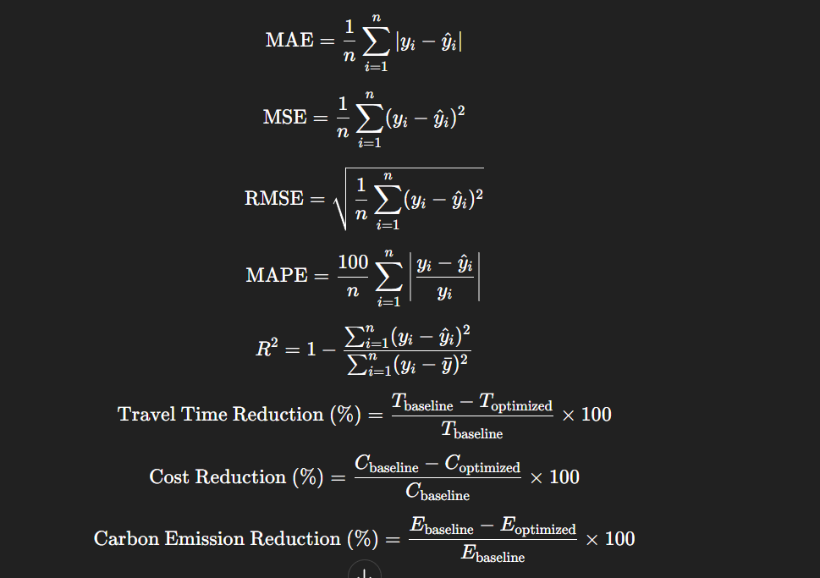
Performance metrics formulae

